Slide 1
Module 11 Case-control study II
PHW 2710 L
Epidemiology III
Miryoung Lee
Notes:
Welcome to Module 11. We will continue on reviewing case-control study designs.

Slide 2
Learning Objectives
Describe biases in case-control studies
Describe methods to control confounding (i.e., matching) and various case-control study designs
Describe statistical methods used in case-controls studies.
Compare and contrast the advantages and disadvantages of
case-control studies.
Notes:
We will talk about potential biases lurking in case-controls studies. Further we will review the study design including matching a little bit in this module. We will go over a little bit more on how to use statistical methods to conduct a case-control study. Finally we will summarize the advantages and disadvantages of case-control studies. Again please remember that case-control study can be referred to as “research in reverse.” Cases and controls are selected first, then we assess exposure related to outcome.
Figure source: Grimes DA and Schulz KF. An overview of clinical research: the lay of the land. Lancet 2002;359:57-61 (Figure 2)

Slide 3
‘Case-based’ case-control studies
Cases
Selection and identification
- Case definition
- Incident or prevalent cases?
- Source of cases?
Controls
Selection and identification
- Source population similar to cases
- Controls from hospitals, neighbors, friends, families, or populations
- Exposure levels are similar to source population
Ascertainment of exposure
How do we collect exposure of interest ?
- Interviews, questionnaires, measurements, electronic records
(e.g., Hospital cases)
Notes:
As you know, the case-control design is an alternative to the cohort study for investigating exposure-disease associations. In relation to time/period, a lot of case-control studies are retrospective studies.
For example, in the simplest strategy for the selection of groups in a case-control study, cases occurring over a specified time period are identified based on case definition. Compared with case-control studies based on cohort study design features, the conventional case-control studies (sometimes called case-based case-control study) are studies in which incident cases, or prevalent cases are identified as the individuals in whom the disease of interest was diagnosed in a certain hospital during a given year. Then, controls are selected from among members of the community served by this hospital, or from same/similar hospitals and controls did not have a diagnosis of the disease of interest by the end of that same year.
The main principle of selecting case and controls is to select cases and controls from the same reference population if possible and these selection should be independent of exposure levels of interest.
The assumption that cases and controls originate from the same hypothetical source cohort or population, even if undefined is critical when judging the internal validity of case-control data. Internal validity is the extent to which study findings (e.g., association) can be attributable to the exposure under investigation.

Slide 4
Bias
Selection bias – related to comparability of groups, confounding and adjustment
Information bias – related to classification of exposure status or outcomes
Performance bias – related to fidelity of the interventions and quality of the intervention information
Attrition bias – related to completeness of sample follow-up and withdrawals between groups
Reporting bias – related to publications biases and selective reporting of results
Handbook-5-1.Cochrane.org
Notes:
As you recall in Module 6 A (selection bias) and 6 B (information bias), we reviewed various biases in depth. Please revisit these module slides again. In most observational studies including case-control studies, we are concerned of selection bias and information bias. However, there are other types biases in observational studies and experimental studies, that you may heard of, listed here for your information only.

Slide 5
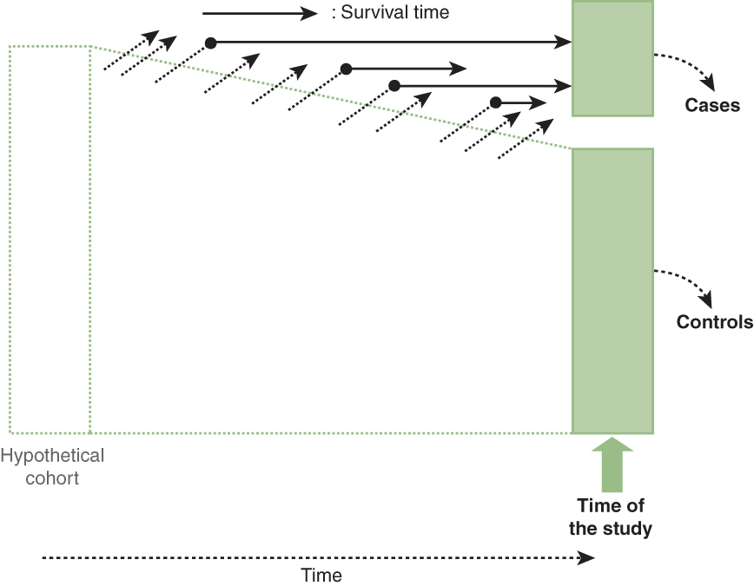
Selection bias
Survival bias
- especially in prevalent cases
Berkson’s bias (or hospital controls)
Pearce and Richiardi, Int J epidemiology 2014;43:521-524 PMID 24585732
Self selection bias
Referral bias
Medical surveillance bias
Sources to know about biases
Univ. of Oxford: https://catalogofbias.org/biases/
http://methods.sagepub.com/Reference/encyclopedia-of-survey-research-methods
S & N, Chap 1. Figure 1-19. Survival bias
Notes:
For case-control studies that include an unbiased sample of the reference or source population, as long as the sampling fraction within the group of cases and that within the group of controls are unaffected by exposure, selection bias does not occur. This sampling strategy yields unbiased exposure odds in cases and controls.
When cases and controls are not selected from the same or similar reference population(s), selection bias may occur.
Selection bias may also occur even if cases and controls are from the same “hypothetical” cohort when “losses” occurring before the study groups are selected affect their comparability.
Only living cases, not including those ‘x’ deceased cases as shown in this figure, are included in the study. Researchers can assume that cases that survive through the time when the study is done are representative of all cases with regard to the exposure. Deaths caused by either other diseases or the disease of interest comprise a particular type of (prior) “loss” that may affect comparability of cases and controls in the study. Those who die before they can be included in the study may have a different exposure experience compared to the rest of the source population. Self selection bias occurs in case-control studies with lower response or participation rates when the likelihood of participating to the study is related to both the exposure and outcome
In Module 6A slides 14-15 describe selection biases that may occurs in case-control studies. Our textbook S & N or Modern epidemiology textbook explains biases in the context of study designs well. However, in some cases, just browsing through the list of biases in various examples will give us a little bit more clear idea of what “that” bias means. For example the Catalog of bias developed by University of Oxford provide brief but clear information on some of well known biases. However, we should be aware of some incorrect definitions of biases provided by various internet site as well or different names for same type of bias.

Slide 6

Information bias
Misclssification
Nondifferential classification of exposure
Differential classification of exposure
Recall bias (or rumination bias by Ernst Wynder)
Inaccurate recall of past exposure
Most often cited type of exposure identification bias in case-control studies
Results in misclassification of exposure status, thus biasing the results of the study
Exposure identification bias
Interviewer bias (or recorder bias)
Notes:
You may recall that bias relates to the PROCESS, that is, the design and procedure of study. Information bias results from either imperfect definitions of study variables or flawed data collection procedures. These errors may result in misclassification of exposure and/or outcome status for a significant proportion of study participants.
Information bias can occur during identification of the exposure and/or the outcome variable in the study. Information bias leads to misclassification of exposure and/or outcome status when the exposure and outcome variables are measured as categorical variables (e.g. yes or no, exposed or not-exposed). There are two types of misclassification: nondifferential misclassification and differential misclassification as you already know. Please re-review our textbook Chapter 4 if you are not clear of nondifferential and differential misclassification. Differential misclassification of exposure between cases and controls can weaken or strengthen the association between exposure and outcome. It is difficult to predict the impact of differential misclassification on the direction and magnitude of association, as it depends on the interplay between the exposure and outcome misclassification.
A major problem in most case control studies is that we ask a history of past exposure. Recall can be problematic. If cases or controls can not remember or having limitation of recall or recall bias. Recall bias is the main form of information bias in case-control studies. It results in misclassification of exposure status. Differential recall of exposure between cases and controls introduces a recall bias into the study.
Interview bias is exposure identification bias and it occurs when investigators seek clarification differentially on responses based upon disease status of participants. This type of bias can also occur when data is collected by review of medical records when the reviewing investigators interpret or record information differently for one group or if the reviewer searches for information more diligently for one group e.g., cases. Since this is introduces a differential misclassification, it can cause bias either toward or away from the null association.

Slide 7

Matching
Controls are matched to selected characteristics of cases (not vice versa)
The selection of controls that are identical, or nearly so, to the case series with respect to one or more potentially strong confounding factors.
Matching is undertaken to address a specific exposure → disease (E → D) association.
Matching or not?
X
E
D
Notes:
There are several approaches to control confounding during design stage or analysis stage of a study. Matching is one of the methods. Practice of matching in case control studies is common and it has been known to be useful in the context of case-control studies when trying to make cases and controls as similar as possible with regard to potential strong confounding factors. In contrast, in cohort studies, matching on potentially confounding variables is not common; but matching is recommended.
In case-control studies, we try to do matching to enable that cases and controls have the same unconditional (marginal) distribution of matching factors. Matching is performed during the selection of controls.
First you must identify matched controls, sometimes more than one per case. Second, since only the discordant pairs contribute to the statistical analysis, achieving a desired statistical power depends on obtaining a particular number of discordant pairs.
In terms of matching, please think of the causal diagram between exposure and disease in mind: why a factor X could or should be a matching factor. Also, please consider that matching is NOT the same concept as matched experiments in animal studies or experimental clinical studies before we proceed.

Slide 8
Matching
It was thought that matching may be an easier way to control for potential confounders with extremely strong effects.
Age in case-control studies of cancer or age related diseases (e.g., Alzheimer disease)
Select cases and controls to be similar with respect to potential confounders
The statistical analysis should account for matching.
Overmatching may cause the effect size to be underestimated if there are similar distributions of the variable of interest (i.e., exposure) between cases and controls
Notes:
Matching is the process of selecting controls to ensure that they are similar to controls with respect to confounding factors. Matching can be performed in pairs or in groups. Many researchers considered matching to be relatively easy way to control for potential confounders with extremely strong effects. Think of age in a study of cancer case and control study. In young age strata, there may be more controls than cases whereas in the old age strata, there may be more cases and fewer controls.
Therefore, statistical precision may be improved if controls are age-matched to cases in order to include approximately equal numbers of cases and controls in each age stratum. If sex is an important confounder to consider, then investigators match every male case with a male control and every female case with a female control, thereby controlling the potential confounder, sex, for example, between cases and controls.
However, we need to be cautious when we match cases and controls by ‘exposure’ status or by variables that are closely associated with exposure. Overmatching based on many variables can result in similar distributions of the variable of interest i.e., exposure between groups being compared, in tern it causes the effect size to be underestimated. In other words, overmatching can underestimate a true association.

Slide 9
Common types of matching
Individual matching - controls matched to one or more 54 year old control (s) to a 54 year old case.
1:1 matching case and missing values
Caliper matching – controls matched to age within 5 years of case
Frequency matching– cases divided into strata of Z, controls matched to those strata
Notes:
Let’s think of types of matching first. We will talk about two most common types: individual matching and frequency matching.
For each case, one or more controls with the relevant characteristics matching those of the cases were selected from the pool of eligible individuals. Individual matching according to naturally categorical variables (e.g., gender) is straightforward. When matching is conducted according to continuous variables (e.g., age), a matching range is usually defined (e.g., the matched control’s age should be equal to the index case’s age plus or minus 5 years), so called caliper matching. Individual matching may be logistically difficult in certain situations, particularly when there is a limited number of potentially eligible controls and/or if matching is based on multiple variables.
Caliper matching is more likely to leave residual confounding.
Frequency matching consists of selecting a control group so as to balance the distributions of the matching variable (or variables) in cases and controls, but without doing a case-by-case individual matching. To carry out frequency matching, we have to know the distribution of the case group in advance according to the matching variable(s) so that the necessary sampling fractions within each stratum of the reference population for the selection of the control group can be estimated. This can be difficult.
If you use 1 control to 1 case and have a missing value for exposure or important covariate in the case or control, we will lose the entire pair during the statistical analysis. So, in most case, it is better to use individual matching using 1:2, 1:3 or 1:4 ratio.

Slide 10
What if controls are matched on…
A factor (X) that is a intermediate factor in the causal chain between the exposure and the outcome
A factor (X) associated with an exposure that is not a confounder but you still perform a matched analysis
A factor (X) that is an effect measure modifier
Notes:
By definition of matching on factor X, it is no longer possible to estimate the effect of X on diseases if the matching is done right to makes the prevalence of X similar in the cases and controls.
Let’s think of some random cases.
What if we match controls on a factor X , which a factor X is found to be an strong intermediate factor (or mediator) in the casual pathways? We will diminish the association between exposure and disease. This problem has no solution.
What If we match on a factor associated with exposure that is not a confounder you must still perform a matched analysis? This results in a loss of power with no gain in internal validity. If we match on a factor X that is associated with exposure E, the controls cannot be used to estimate the prevalence of X or E in the population. Controls are no longer population-based controls.
What if we match controls on a factor X, which a factor X is found to be an effect measure modifier? It is still possible to study X as an effect measure modifier on the multiplicative scale but not on the additive scale.

Slide 11
Matching
Benefits of matching
Control strong confounders?
Increase statistical power or efficiency?
Costs of matching
Cannot analyze the effect of a matched variable(s)
Can take a long time to match controls to cases
May limit study’s external validity (generalizability)
Notes:
The primary statistical reason for matching in case-control studies was to improve the efficiency (reduce the variance) of the effect estimates upon adjustment for the matching factors. The gains in efficiency are directly associated with the strength of the association between matching factor and outcome and inversely related to the strength of the association between exposure and outcome. It is important to match on strong confounders only, as matching on weak ones will not help the efficiency or statistical power of a study, which can be another advantage of matching.
Other possible benefits for matched case-control designs are 1) to enable adjustment for confounding variables efficiently which are difficult to measure or obtain, such as use of siblings as controls may help to adjust for genetic factors, sparse-data problem, and 2) to provide a convenient sampling frame for controls, for example we may sample controls who are individually matched to cases from the same neighborhood without enumerating the entire population. It may be prohibitively expensive to create a sampling frame to identify controls. In a hospital based case control study of caffeine intake and preterm birth, matched controls may be obtained for each case or preterm birth by selecting the next 3 eligible births as the controls (1:3) from the same hospital. This will eliminate the time-consuming task of listing all births in the community.
However, there are cases when matching is not recommended, or when matching serves as a disadvantage in a case-control study. Please refer to our textbook S & N on pages 39-41 for more details.

Slide 12

Criticism on matching in case-control studies
Does matching in case-control studies reduce confounding?
When matching is done based on a confounding factor(s) related to exposure in the source population, selection bias can be introduced by the matching process.
Should we need to use only matched statistical analysis methods?
“if there is an association between the matching factor and the exposure, then matching will introduce confounding that needs to be controlled for in the analysis” - Pearce N BMJ 2016
Pearce N BMJ 2016; Mansournia et al., Eur J Epidemiol 2018
Notes:
Based on causal diagrams or causal theory, some researchers argued or have provided that matching in many case-controls studies do not reduce confounding or rather introduce selection bias. Please read two references by Neil Pearce and by Mansournia et al for more details. Without careful consideration of causal diagram between exposure and outcome in relation to matching factors, case-control matching does not prevent confounding by the matched variables and control of matching variables may be necessary even if those were not confounders initially.
References:
Pearce N. Analysis of matched case-control studies. BMJ.2016;352:i969 PMC4770817
Mansournia, Jewell, and Greenland. Case-control matching: effects, misconceptions, and recommendations. Eur J Epidemiol 2018;33:5-14
Rothman, Greenland, Lash. Modern Epidemiology 3rd ed. Pp. 175-182

Slide 13
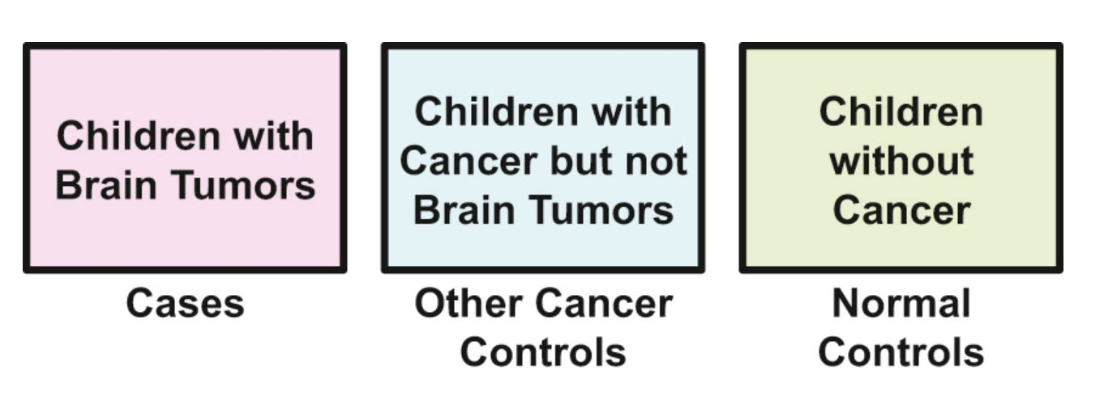
Use of multiple control sets
Controls of the same type
Multiple controls of different types
Gordis Epidemiology 6th Ed. Figure 7.13
Notes:
In a case-control study, you also often see that the investigators include multiple controls for each case. This can occur in the context of matched or unmatched study design. Numbers of controls per case up to 5 or less than 5 have been thought as better in terms of efficiency or gaining the statistical power. These multiple control sets can be controls of same type or controls of different types. Many case-controls use the same type of controls from the source population that they selected from cases. Because we are studying rare outcomes in case-control study, we are limited to have a relatively smaller number of cases. Without expanding the study per se (e.g., multicenter studies), the option to increase controls for each case is often chosen in order to gain statistical power.
On the other hand, some investigators chose multiple controls of different types. As shown in this example figure, copied from Gordis Epidemiology textbook, Gold and her team chose two types of controls for each case, i.e., children with brain tumors to investigate the study question, “Did mothers of children with brain tumors have more prenatal radiation exposure than control mothers”. If the exposure of prenatal radiation is different between cases and normal controls resulting in significant EOR, but not between cases and other cancer controls, then the prenatal radiation may not be a specific exposure in relation to brain tumors. The difference in exposure can occur due to true difference or maternal recall of radiation exposure. Oppositely, if the exposure of prenatal radiation is different between cases and both controls, then we suspect that the prenatal radiation is a specific exposure to brain tumors at least in this study. In hospital based case-controls, including multiple controls of different types could be quite valuable in exploring alternative hypotheses (or 2nd study question) and in considering possible biases such as recall bias, like in maternal recall of radiation exposure.
Reference: EB Gold, L Gordis, J Tonascia, et al.: Risk factors for brain tumors in children. Am J Epidemiol. 109:309-319 1979

Slide 14
Case-control studies within the cohort
Chunk 3 – nested case-control study (https://www.youtube.com/watch?v=8P5I63hbHnc)
Chunk 4 – case-cohort study (https://www.youtube.com/watch?v=jk-XHRDEJ4k)
Notes:
I hope you already reviewed video lectures posted on edX:Stata Learner for case-control studies that take advantages of cohort study design. In both nested case-control and case-cohort designs, cases and controls are derived from the same original cohort, so there is likely to be greater comparability between the cases and the controls (or same source population) than one might ordinarily find in a traditional case-control study.
These study designs not only have many benefits as listed on next two slides, but also help the researchers to estimate rate ratio or risk ratio as shown in Module 2.
For all of these reasons, the cohort-based case-control study is an extremely valuable type of study design.

Slide 15
Nested case-control study
Advantages
Efficient – not all members of parent cohort require diagnostic testing
Flexible – allows testing of hypotheses not anticipated when the cohort was drawn (at t₀)
Reduces selection bias – cases and controls sampled from same population
Reduces information bias – risk factor exposure can be assessed with investigator blind to case status
Disadvantages over cohort study
Reduces power (from parent cohort) because of reduced sample size by: 1/(c+1), where c = number of controls per case
https://newonlinecourses.science.psu.edu/stat507/node/49/
Notes:
As shown in Module 10, slide 11, in as nested case-control study, the controls are selected at each time when a case occurs. In other words, cases are compared with controls who are at risk at the time when each case occurs, but who do not experience the disease. At the beginning of the cohort study (t₀), members of the cohort are assessed for risk factors. Cases and controls are identified subsequently at time t_{1.} The control group is selected from the risk set (cohort members who do not meet the case definition at t₁.) In this way, the cases and controls are, in effect, matched on calendar time and length of follow-up. Typically, the nested case-control study is less than 20% of the parent cohort. Because a control is selected each time a case develops, a control who is selected early in the study could later develop the disease and become a case in the same study.
Nested case-control studies can be conducted in a matched, or not matched way. Matching cases to controls according to baseline measurements of one or several confounding variables is done to control for the effect from confounding variables. Conditional logistic regression analysis or cox proportional hazards regression analysis are usually used. The disadvantage to nested case-control studies are the reduced precision and power due to sampling of controls, and the possibility of flaws in the sampling design or its implementation.
Source: https://newonlinecourses.science.psu.edu/stat507/node/4
Reference: Ernster VL. Nested case-control studies. Prev Med. 1994 Sep;23(5):587-90. PMID: 7845919

Slide 16
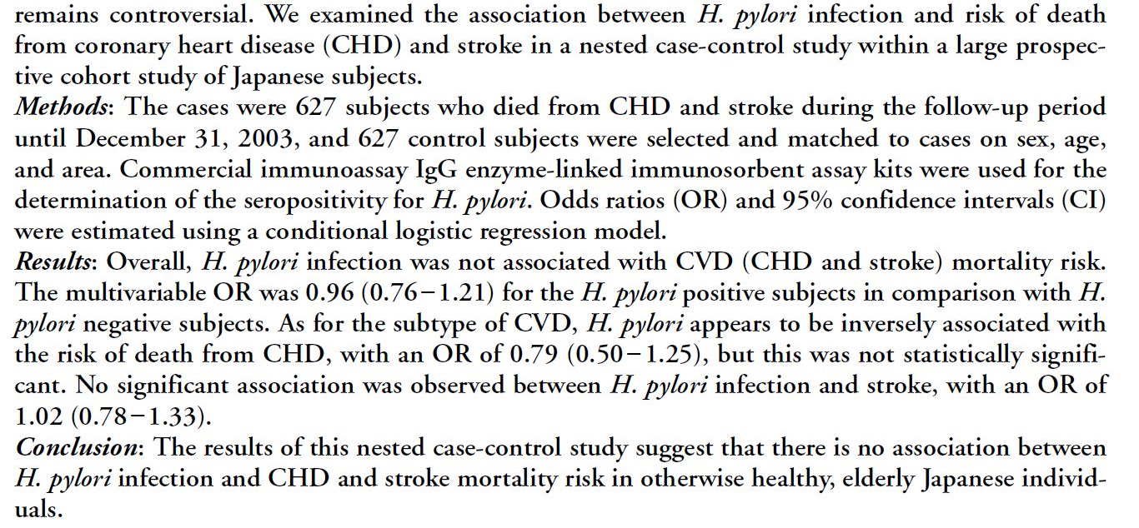
Helicobacter Pylori infection and CVD death
Lin Y et al., J Atheroscler Thromb 2015;22:1207-1213. PMID: 26084791
Notes:
Let’s look at one example of nested case-control studies. This slide contains the portion of published abstract. Lin et al. examined between H. pylori infection and risk of death from coronary heart disease (CHD) and stroke in a nested case-control study using a cohort study called the Japanese Collaborative Cohort Study for Evaluation of Cancer Risk (JACC study). According to the authors, JACC study is a large prospective study that aimed to investigate associations between various lifestyle factors and various outcomes including mortality. The study is based on more than 110,000 Japanese aged between 40-79 years old and these participants were recruited from 45 locations between 1988-1990. For this particular study, the authors used the baseline blood samples, which were available in 30% of baseline participants to assess the exposure between matched case-controls. The authors matched controls to cases (1:1 matching) based on age, sex and area of recruitment and used “conditional logistic regression” analysis to adjust for matching factors in the analysis.
Please read the article over to see how the authors carried out the nested case-control study within JACC study and to contemplate why this study design would be better than conventional case-control studies of H pylori infection and CVD risk. For example, think of temporal sequence between infection and CVD, availability of bio samples, and efficiency of matching and its relationship to confounding.
Reference: Lin Y et al., Helicobacter Pylori Infection and Risk of Death From Cardiovascular Disease Among the Japanese Population: a Nested Case-Control Study within the JACC Study. J Atheroscler Thromb 2015;22:1207-1213. PMID: 26084791

Slide 17
Case-cohort study
Advantages
All advantages of nested case-control study design
The subcohort can be used to study multiple outcomes
Risk can be measured at any time up to t₁ (e.g. elapsed time from an exposure to outcome/event, such as menopause, birth)
Sub-cohort can be used to calculate person-time risk
Disadvantages
Increased potential for information bias because subcohort may have been established after t₀
Exposure information collected at different times (e.g. potential for sample deterioration)
https://newonlinecourses.science.psu.edu/stat507/node/4
Notes:
In a cohort study, we assume the baseline cohort is a representative or general population that you target to study. Controls are selected from the baseline cohort or population at risk at the beginning of the follow up period in which the case-control study is nested.
A case-cohort study is similar to a nested case-control study in that the cases and non-cases are within a parent cohort; cases and non-cases are identified at time t₁, after baseline. In a case-cohort study, the cohort members were assessed for risk factors at any time prior to t₁. Non-cases are randomly selected from the parent cohort, forming a subcohort as shown in Module 10, slide 12. The case-cohort study has all advantages of nested case-control study design. Using case-cohort study, it is also possible to study different diseases (different sets of cases) using the same cohort for controls.
Source: https://newonlinecourses.science.psu.edu/stat507/node/4
Reference: Ernster VL. Nested case-control studies. Prev Med. 1994 Sep;23(5):587-90. PMID: 7845919

Slide 18
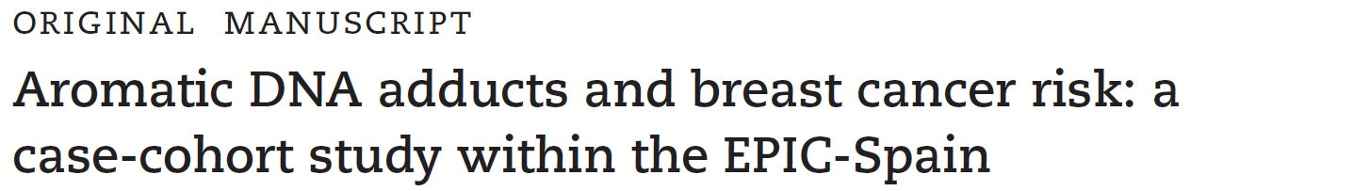
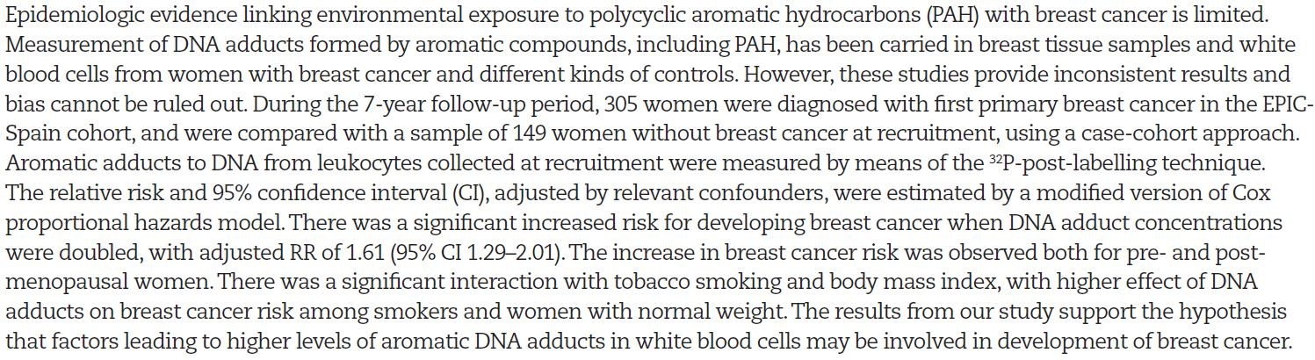
Notes:
Let’s look at one example of case-cohort studies. This slide contains the portion of published abstract. Agudo et al. aimed to examine the environmental exposure to polycyclic aromatic hydrocarbons (PAH) and breast caner risk on 305 cases and 149 women without breast cancer based on the Spanish cohort of the European Prospective Investigation into Cancer and Nutrition (EPIC) study. The Epic Spain cohort has 41,438 subjects with more 25000 women, between ages 29-69 at baseline. These were recruited between 1992-1996 from five Spanish regions. The authors used baseline buffycoat samples to measure levels of DNA adduct and its relationships to breast cancer incidence and estimated relative risk based on cox proportional model (hazard ratios from a proportional hazards model). Please read the article thinking of what we learned about a case-cohort study design. This article also reported the effect measure modification by smoking status and body mass index on the relationship (Table 4).
Reference: Agudo A et al., Aromatic DNA adducts and breast cancer risk: a case-control study within the Epic-Spain. Carcinogenesis 2017;38:691-698. PMID: 28535209

Slide 19
Statistical analysis- matched Chi-square test for contingency tables Conditional logistic regression analysis
Notes:
Let’s take a look at statistical analysis methods that is used for matched case-control studies. Contingency table analysis based on McNemar’s test and conditional logistic regression are reviewed in this module.
I hope by now it is comfortable for you to conduct a simple or multiple logistic regression analysis using STATA, or SAS.

Slide 20
Matched case-control studies
Exposure | Outcome
 |  | Yes | No
 | Yes | a | b
 | No | c | d
Concordant pairs in cells ‘a’ and ‘d’
Discordant pairs in cells ‘b’ and ‘c’
Traditional or unmatched case-control study
 |  | Controls
 |  | Exposed | Unexposed
Cases | Exposed | a (+/+) | b (+/-)
 | Unexposed | c (-/+) | d (-/-)
Notes:
Suppose we plan to match nonfatal heart attack (MI) cases to controls by gender and age (+/- 5 years) to examine the relationship between H. pylori infection and nonfatal MI like our previous example (Lin et al, nested case-control study). In this example, we are going to design a hospital based case-control study.
We first identify the following MI case:
Case 1 is a man, 45 years of age and he was exposed to infection (Patient 1). Thus his exposure status is coded as “Exposed”.
In an age- and gender-matched case-control study, we must also find a male control within five years of age. Searching through the appropriate control population, we find the following control: Male ,48 years of age (Person 47); Exposure status: Exposed
If Person 47 were counted in an unmatched study, he would belong to cell B of the 2 x 2 table located in upper right corner. In a matched case-control study however, we are interested in results from the matched pair.
The data from Patient 1 and Person 47 are linked for age and gender. The appropriate table for the matched study is depicted above.
Where do Patient 1 and Person 47 belong in this case?
The pair should in cell ‘a’.
Concordant pairs in cells ‘a’ and ‘d’, are pairs in which both the case and the control were exposed, and pairs in which neither the case nor the control was exposed
Discordant pairs in cells ‘b’ and ‘c’, are pairs in which the case was exposed but the control was not, and pairs in which the control was exposed and the case was not.

Slide 21


Matched case-control studies
Measure of association (Odds Ratio): Only the discordant pairs in cells b and c contribute to the OR.
McNemar’s chi-square test statistic:
$χ^{2}$ = $\frac{{(b−c)}^{2}}{b+c} or χ^{2}= \frac{{(\left|b−c\right|−1)}^{2}}{b+c}$ , where b + c < 25
approximately follow the chi-square distribution with df = 1
 |  | Controls
 |  | Exposed | Unexposed
Cases | Exposed | a (+/+) | b (+/-)
 | Unexposed | c (-/+) | d (-/-)
$$SE (\log{OR)= \sqrt{\frac{1}{b}+ \frac{1}{c}}}$$
$95\%CI\left(OR\right)$ $=exp[\log\left(OR\right)±1.96 ×SE (\log{OR)]}$
Notes:
We can define two types of matched pairs by the similarity or difference of the exposure of the case and control in each pair.
The OR for matched case-control study is calculated based on only discordant pairs (b and c). The odds ratio shown here for matched studies is sometimes called the paired OR, but can also be referred to as a Mantel-Haenszel OR, as strata are defined given the matched pairs in a study. Mantel-Haenszel method is sometimes called as Cochran-Mantel-Haenszel (CMH) method. CMH method or special form of CMH, McNemar test, is used to test whether matched OR is significantly different from 1.
Appendix A.4 (Matched case-controls study) describe more how to do in relation to Chapter 7 examples (Table 7-12, Table 7-13)
If you are using statistical program, Cochran-Mantel-Haenszel-test is used to produce the OR and to test whether OR is significantly different from 1.

Slide 22
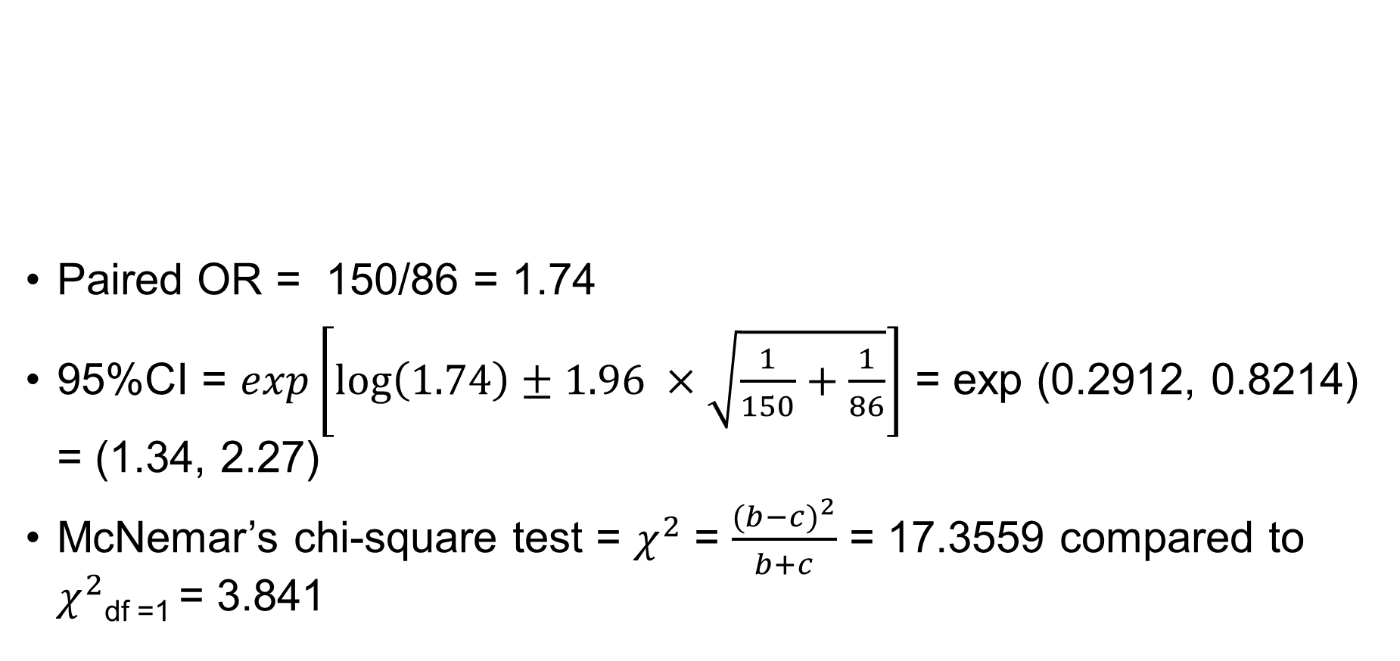
Example: H. pylori infection and MI
 |  | Controls
 |  | Exposed | Unexposed
Cases | Exposed | 570 | 150
 | Unexposed | 86 | 794
Paired OR = 150/86 = 1.74
95%CI = $exp\left[\log\left(1.74\right)±1.96 ×\sqrt{\frac{1}{150}+\frac{1}{86}}\right]$ = exp (0.2912, 0.8214) = (1.34, 2.27)
McNemar’s chi-square test = $χ^{2}$ = $\frac{{(b−c)}^{2}}{b+c}$ = 17.3559 compared to $χ^{2}$_{df =1} = 3.841
Notes:
Let’s pretend that we want to examine the relationship between H. pylori infection and MI in a population based case- control study. We have a hypothetical data set like shown here in this slide. This study hypothetically used individual matching (age and gender) with 1:1 matching ratio to identify controls to MI cases. Let’s calculate the OR and 95%CI for OR.
For this example, paired OR is 1.74 and 95%CI for paired OR falls between 1.34 and 2.27, which interval does not include ‘1’.
According to McNemar’s chi-square test statistic (17.36), the hypothesis testing on the null hypothesis (paired OR = 1) revealed that we do reject the null hypothesis at the significant level (alpha) of 0.05.
Let’s use STATA to do similar analyses.

Slide 23
STATA: contingency table analysis on grouped data
(input group data)
. mcc cases controls [fw=count]
Notes:
As you can see, the CMH (Cochran-Mantel-Haenszel) method produced the same odds ratio (1.74) as we calculated in previous slide.
Also, McNemar’s chi-square test statistic is also produced and it is 17.36.
There are two example datasets included with this module: H pylori and MI grouped or H pylori and MI longformat datasets.
Please use the grouped data to practice on your own.
As you can see, matched OR from STATA turns out to be 1.744 and 95% confidence intervals range 1.329 to 2.301 (if you are using exact method).
Considering that 95%CIs are above 1 and not including 1 suggesting that the OR is significantly differently from 1.
An OR of 1.744 indicates that the odds of outcome is about 1.744 times more frequent in the exposed group for the population of interest.

Slide 24
Stata: conditional logistic regression analysis
. clogit outcome matchedpair, or group(id)
Notes:
As you can see, the use of conditional logistic regression method produced same paired OR and 95%CI like in slide 25.
The STATA command used here is based on individual observations from the grouped data. As you noticed, 1364 concordant pairs (2728 observation) were not included in the analysis while 236 discordant pairs (150 + 86) or 472 observations were included in the analysis. “or” command results in ‘paired OR information’ on the output.
Please use the long format example data that were uploaded with this module to practice on your own.

Slide 25
Example – matched case control study with 1:3 matching
Exposed? | case | control | Total (N) | No of matched sets | Numerator = (a x d)/N | Denominator = (b x c)/N | Matched sets* num | Matched sets* den
yes | 1 | 0 | 4 | 40 | 0.75 | 0 | 30 | 0
no | 0 | 3
yes | 1 | 1 | 4 | 60
no | 0 | 2
yes | 1 | 2 | 4 | 12
no | 0 | 1
yes | 1 | 3 | 4 | 10
no | 0 | 0
yes | 0 | 0 | 4 | 30
no | 1 | 3
yes | 0 | 1 | 4 | 5
no | 1 | 2
yes | 0 | 2 | 4 | 7
no | 1 | 1
yes | 0 | 3 | 4 | 20
no | 1 | 0
Notes:
Please note the Mantel-Haenszel OR can also accommodate more than one control per case.
Chapter 7, section 7.3 in our S & N textbook illustrates how to use M-H method to calculate M-H OR in a matched case-control study with 1:M matching.
This hypothetical example is from exercise examples on page 344 in our textbook. Please check out the calculation on page 277 to complete this stratification based calculation to calculated paired OR.

Slide 26
Example – matched case control study with 1:3 matching
Exposed? | case | control | Total (N) | No of matched sets | Numerator = (a x d)/N | Denominator = (b x c)/N | Matched sets* num | Matched sets* den
yes | 1 | 0 | 4 | 40 | 0.75 | 0 | 30 | 0
no | 0 | 3
yes | 1 | 1 | 4 | 60 | 0.50 | 0 | 30 | 0
no | 0 | 2
yes | 1 | 2 | 4 | 12 | 0.25 | 0 | 3 | 0
no | 0 | 1
yes | 1 | 3 | 4 | 10 | 0 | 0 | 0 | 0
no | 0 | 0
yes | 0 | 0 | 4 | 30 | 0 | 0 | 0 | 0
no | 1 | 3
yes | 0 | 1 | 4 | 5 | 0 | 0.25 | 0 | 1.25
no | 1 | 2
yes | 0 | 2 | 4 | 7 | 0 | 0.50 | 0 | 3.50
no | 1 | 1
yes | 0 | 3 | 4 | 20 | 0 | 0.75 | 0 | 15.00
no | 1 | 0
Notes:
Conditional logistic regression analysis method can easily accommodate 1: M matching data as well. You will need to assign matched controls and cases in same group ID: e.g., group (pairedID).
Calculations in the first stratum (no of matched sets = 40) is color-coded for your information. For example, matched sets * numerator in the first stratum is calculate as [(1*3)/4]*40 = 30.
OR_{MH} is calculated as the sum of ‘matched sets * numerator’ divided by the sum of ‘matched sets * denominator’, which is 63/19.75. This calculation results in OR_{MH} = 3.1899 .
Just be aware that stratification based calculation like MH method will let you conduct only for one association at a time between an independent variable and an outcome and limited.
However, conditional logistic regression analysis will let you adjust for other confounding factors regardless of numbers of types of variables (categorical or continuous variables).

Slide 27

Advantages of case-control studies
Useful study design for uncovering etiology in rare diseases
Important study design in understanding new diseases
Useful if induction period is long
Time efficient and relatively less expensive compared to cohort studies
Notes:
These two slides summarize advantages and disadvantages of case-control studies.
These lists are more related to conventional case-control studies because case-control studies nested in cohort studies have additional benefits.

Slide 28
Disadvantages of case-control studies
Inefficient study design to study rare exposures
Susceptible to bias
Exposure misclassification
Recall bias
Restricted to single outcome
Temporal ambiguity
Ineffective when the outcome (dependent variable) is measured as a continuous variable
Notes:
Again some of disadvantages can be avoided using case-control studies within the cohort. For example, the case-cohort study can be used to study multiple outcomes. However, if the exposure was not assessed at the beginning of cohort study because it was not part of study interest, the temporal ambiguity between exposure and outcome still occur.
In general, when we were asked about advantages and disadvantages of case-controls studies, we are referring to “conventional” case-control studies but not case-control studies conducted within the cohort.
Next week, we will review the cohort study that is a source for nested case-control or case-cohort study.

Slide 29

Acknowledgements
This presentation includes some material/examples/slides from:
Szklo & Nieto, Epidemiology: Beyond the Basics 4th Edition
Celentano & Szklo, Gordis Epidemiology, 6th Edition
Dr. Elaine Symanski (Fall 2018, Epidemiology III)
STAT507: Epidemiological Research Methods lectures: Penn State Eberly College of Science https://newonlinecourses.science.psu.edu/stat507/node/49/
edX: Week 8 Case-control studies, Harvard University, School of Public Health https://www.youtube.com/watch?v=BQI2NjzPU68&list=PL6p7gIm6aWd_lAKqGWgtYNORVL01DJSuI&index=1

